Slide 1
Learning R Workshop
A Rough and Rowdy Rodeo with R

Slide 2
What We Covered
Why use R?
Packages and the working directory
Saving and loading data
Descriptive statistics
Transformations
Inferential statistics

Slide 3
Outline for Today
Object permanence Object-oriented programming
R’s basic data structures
Splitting and subsetting data
Visualizing your data
Advanced data wrangling (‘plyr’ package)
Troubleshooting problems with R
Your next steps

Slide 4

The 5-Minute Intro to Programming

Slide 5
What Is an Object?
R is an object-oriented language
In programming, objects are like generic containers to put information into
R objects have attributes (properties that describe them) and methods (functions that let you do things with the object)

Slide 6
Objects in R
Additionally, objects need a name
Objects are stored in a location in your computer memory
Need to be able to tell R to refer back to that particular location
R creates a dictionary called a “namespace” to keep track of all the names of the objects and the memory locations they refer to
data >> <0ADC64B8>
vector1 >> <0BE13498>
newobj >> <0ABC25C0>

Slide 7
Objects in R
R objects are created and given a name using the “assignment arrow”
group.1 <- c(4, 6, 8, 7)
group.2 <- c(2, 1, 3, 2)
You can store analyses in objects as well
analysis <- t.test(group.1, group.2)
Extract attributes from objects
analysis$statistic
Use objects in a function
boxplot(group.1, group.2)
Split one object into new, smaller objects
data_control <- subset(data_all, condition == "Control")

Slide 8

Why Are Objects Useful?
Once you start thinking about statistics in an object-oriented way…it’s a whole new world

Slide 9
Why Are Objects Useful?
Both data and statistical analyses are objects that you want to know things about (i.e., attributes) and want to do stuff with (i.e., functions)
Instead of an analysis as output, your analyses are now objects you can manipulate further
Instead of dealing with your dataset as one big mass, you can slice and dice it and grab just what you need – as many times as you want!

Slide 10
Why Are Objects Useful?
For example:
Want to run same linear regression analysis on five DVs, and pull out the R² for each
Subset your data to select just the relevant columns
Use the regression function on your data object
Save each analysis as a new object
Pull out a specific attribute (R²) from each
Collect those attributes into a new object, make into a pretty table or graph!

Slide 11
Go to code

Slide 12
Exercise
Find the number of participants in data that:
Were in Rumination condition and had maximizing score greater than 5
Felt closeness before task between 50 and 60
Were in Control condition and chose not to make a change
(Hint: Use nrow() to get number of rows in a data frame!)

Slide 13
Go to code

Slide 14
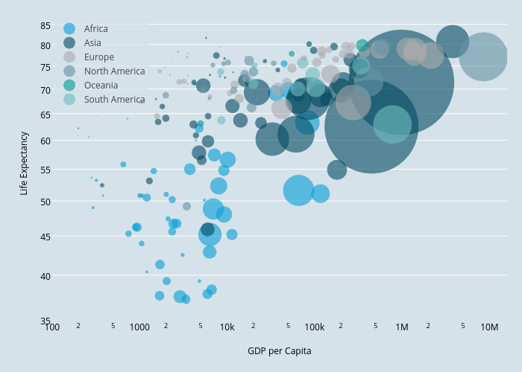
Graphing Your Data

Slide 15
Graphing in R
There are some basic functions to create plots built into R:
E.g., plot(), hist(), boxplot()
However, the ‘ggplot2’ package is the most commonly used graphics package within R (#1 package most frequently directly downloaded)
Very powerful and flexible

Slide 16
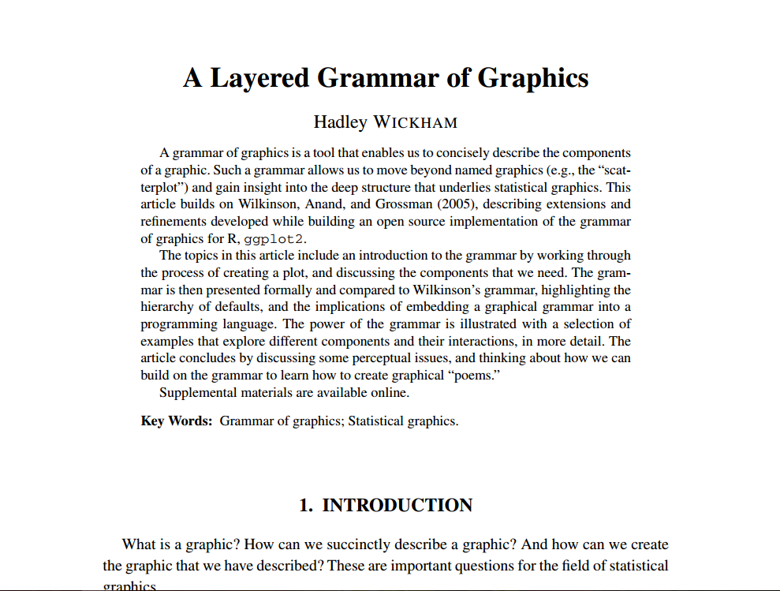
ggplot2 and the Grammar of Graphics
http://vita.had.co.nz/papers/layered-grammar.pdf

Slide 17
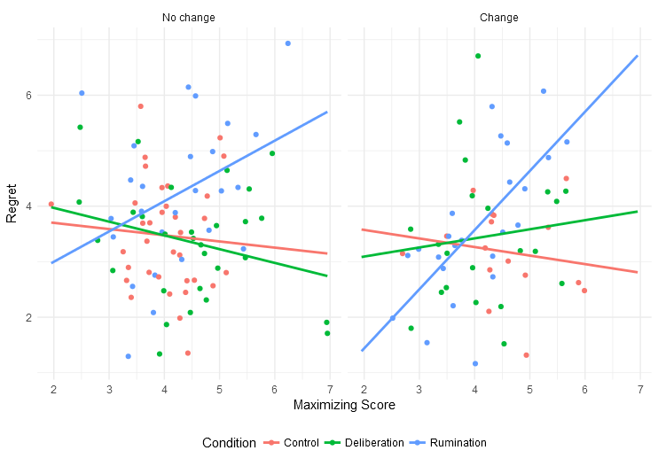
Facets:
For multiple subplots
in a single plot
Geometric objects:
Dots, lines, boxplots,
shapes, etc.
Scales:
Transformations, coordinates
Aesthetic mappings:
x = max_score
y = regret
colour = condition

Slide 18
Plots
Each plot contains:
A default dataset and mappings from variables to aesthetics
One or more layers, with each layer containing one geometric object (“geom”)
Different layers can use different aesthetics, e.g., the “shape” aesthetic doesn’t apply to a bar graph, but it does apply to a scatterplot
One scale for each aesthetic, mapped to a set of coordinates
Specification of facets, if any

Slide 19
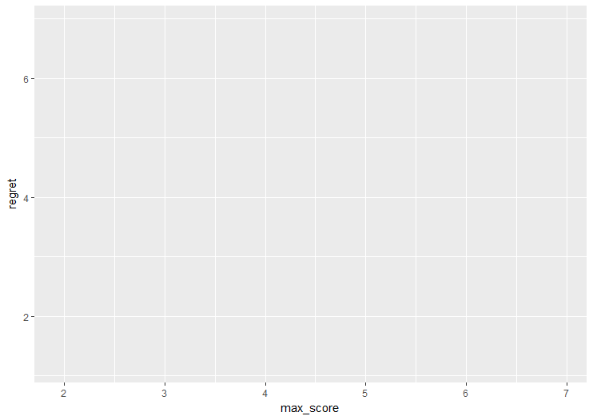
ggplot(data, aes(x=max_score, y=regret))
Specify dataset
Map variables to aesthetics

Slide 20
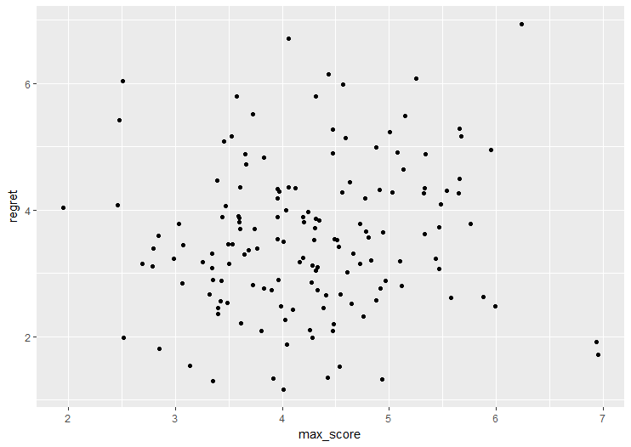
ggplot(data, aes(x=max_score, y=regret)) +
geom_point()
Add a scatterplot layer, using overall plot aesthetics

Slide 21
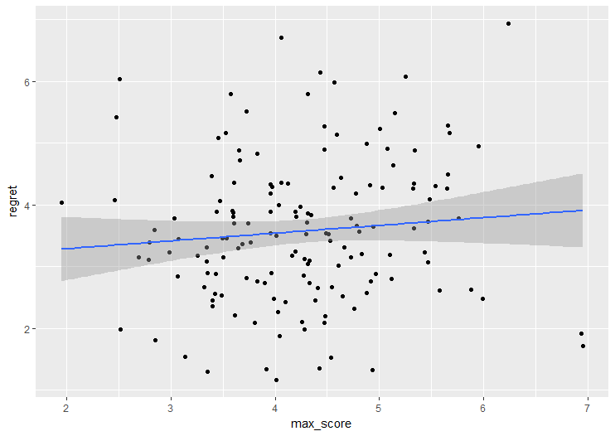
ggplot(data, aes(x=max_score, y=regret)) +
geom_point() +
geom_smooth(method="lm")
Add a smoothed regression line

Slide 22
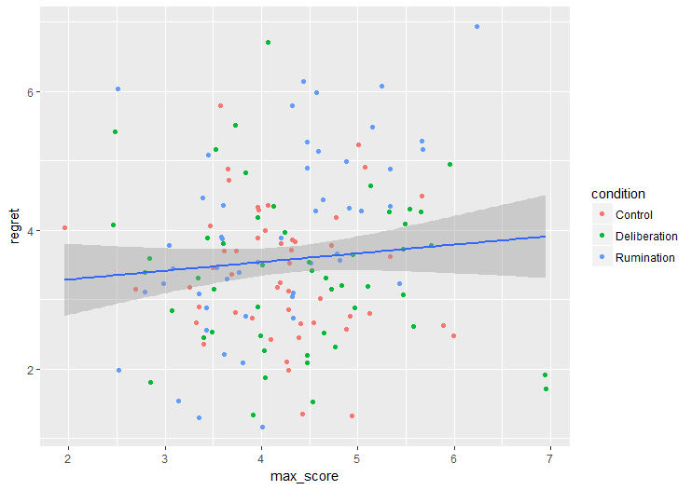
ggplot(data, aes(x=max_score, y=regret)) +
geom_point(aes(colour=condition)) +
geom_smooth(method="lm")
Add colour aesthetic just to
scatterplot

Slide 23
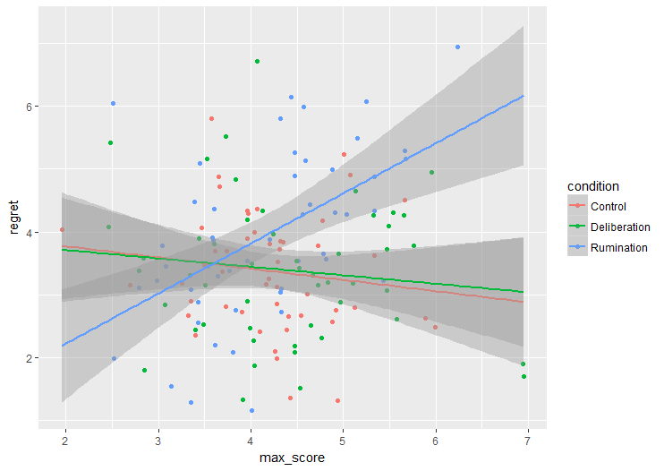
ggplot(data, aes(x=max_score, y=regret, colour=condition)) +
geom_point() +
geom_smooth(method="lm", fullrange=TRUE)
Add colour aesthetic to
both layers

Slide 24
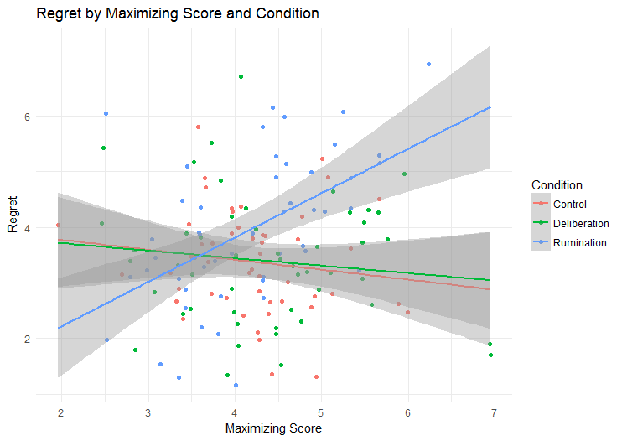
ggplot(data, aes(x=max_score, y=regret, colour=condition)) +
geom_point() +
geom_smooth(method="lm", fullrange=TRUE) +
theme_minimal() +
labs(title="Regret by Maximizing Score and Condition",
x="Maximizing Score", y="Regret", colour="Condition")
Change theme,
add labels

Slide 25
Some Tips for Using ggplot2
Give it the data you actually want it to use
If you want to plot means, don’t give it your raw data – give it the means!
ggplot has some summary functions you can use, but usually better to get in habit of structuring the data yourself
Build up your plots incrementally
Lots of help and examples available online!

Slide 26
Go to code

Slide 27

The ‘plyr’ Package

Slide 28
The plyr Approach
SPLIT
APPLY
COMBINE
your data into chunks
a function to each piece
all the pieces back together

Slide 29
An Example
id | condition | regret
1 | Control | 2
2 | Control | 4
3 | Control | 1
4 | Control | 3
5 | Control | 2
6 | Deliberation | 2
7 | Deliberation | 2
8 | Deliberation | 4
9 | Deliberation | 4
10 | Deliberation | 1
11 | Rumination | 4
12 | Rumination | 3
13 | Rumination | 7
14 | Rumination | 6
15 | Rumination | 4
mean()
condition | mean
Control | 2.40
Deliberation | 2.60
Rumination | 4.80
mean()
mean()

Slide 30

The plyr family

Slide 31
The plyr family
Input | Output
 | Array | Data frame | List | Discarded
Array | aaply() | adply() | alply() | a_ply()
Data frame | daply() | ddply() | dlply() | d_ply()
List | laply() | ldply() | llply() | l_ply()
Can also be used with vectors!
[input][output]ply()

Slide 32
Basic Format of ddply( )
output <- ddply(input_data, .(split_variables), function, ...)
If your function has any other parameters it needs to work properly, add them after the comma

Slide 33
Some Useful Built-In Functions
mutate:
Creates new variables in a dataset (and keeps the whole dataset)
summarise/summarize:
Like mutate, but creates a new dataset with just the specified values

Slide 34
Go to code

Slide 35

Troubleshooting Problems in R

Slide 36
The R-t of Communication
In addition to the regular output, R can provide a couple types of messages, which show up in red
Errors
Errors happen when R is executing a function and terminates
If an error occurs, you must fix the problem, because R will stop on an error
Warnings
Warnings occur when R had to do something that may make its actions invalid, but it went ahead and finished execution
It’s a sign that something might be wrong, but if you understand the root cause of the warning and are okay with what happened, you do not need to fix the problem

Slide 37
Multiple Error Messages
Error messages have a cascading influence
If you get a bunch of error messages:
Scroll up in the console to the last command you ran
Scroll down through the error messages and try to solve them in sequential order
If you solve an early error message, run the command again, because this may fix the later errors
Function A
Function B

Slide 38

What to Expect When You’re Rxpecting
R is case-sensitive
When I get an error, the first thing I do is check for typos
Package documentation can be helpful…depending on the package
Lots of help online
Google is your greatest ally
Typos

Slide 39
Finding Help Online
Try prefixing your search with “r” or “rstats”
Stack Overflow website is a fantastic resource – if this pops up in your search results, check here first!
https://stackoverflow.com
R-help mailing list also has lots of good information
https://stat.ethz.ch/mailman/listinfo/r-help
R-bloggers has lots of great tutorials with example code
https://www.r-bloggers.com

Slide 40
Finding Help Online
If you are looking for help with a particular task, try to be as descriptive as possible:
“r plot means for each condition”
If you run into an incomprehensible error message, try pasting it into Google for clues about what might have gone wrong
Take out any of the details that look like they’re specific to your case, like number of cases or object names

Slide 41
Finding Help Online
If all your Google searching fails, sign up on Stack Overflow and ask your question there
The people there are incredibly helpful, and voting means better answers tend to rise to the top
Asking your question online can also help the next person who has the same problem!

Slide 42
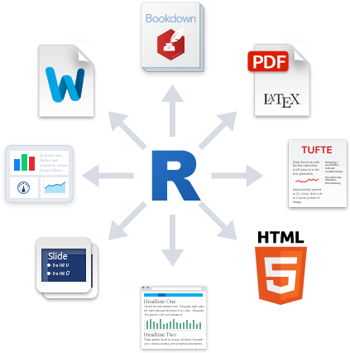
R Markdown and R Notebooks

Slide 43
R Markdown and R Notebooks
Markdown is a simple formatting syntax (e.g., bold, italics, headings, links) designed to be human-readable, but also easily converted to HTML
This syntax: | Produces:
*italics* | italics
**bold** | bold
# Header 1 | Header 1
## Header 2 | Header 2
[link](http://www.google.ca) | link

Slide 44
R Markdown and R Notebooks
R Markdown combines Markdown formatting with the ability to run chunks of R code within the document
This lets you intersperse text and code
Can be converted to a variety of formats, including HTML, Word, and PDF
Useful for summaries of results, documenting analyses, and even creating full manuscripts
See cheat sheet: https://www.rstudio.com/wp-content/uploads/2015/02/rmarkdown-cheatsheet.pdf

Slide 45
R Markdown
In RStudio, select File > New File > R Markdown
To insert code chunk, click “Insert” button at top of script panel, or press Ctrl+Alt+I
(Mac: Command+Option+I)
Produces this:
```{r}
# code goes here
```

Slide 46
R Markdown
When you are ready to see what HTML/Word/PDF document looks like, click the “Knit” button at top of scripts panel
Creating these files is handled by ‘knitr’ package
Will run all the chunks in your document, then format according to type of output
Useful packages:
For APA formatting, see ‘papaja’ package
‘citr’ adds RStudio extension to search and insert references

Slide 47
R Notebooks
Takes R Markdown one step further: when code chunk is run, output is immediately inserted directly beneath it
Persistent: Outputs show up the next time you open the document
Patterned after iPython/Jupyter Notebooks
Still is an .Rmd document, so can still be knitted like any other R Markdown document

Slide 48
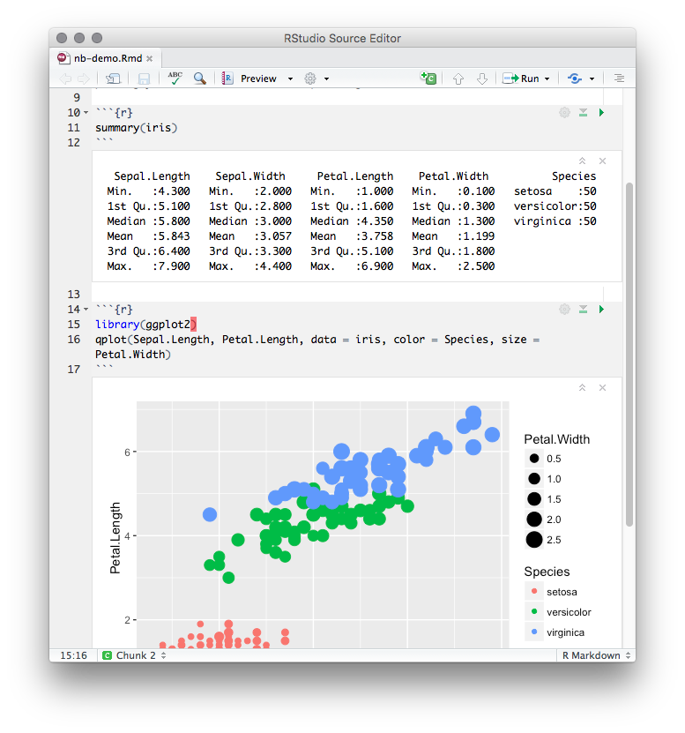

Slide 49
R Notebooks
Most useful for primary analyses – can easily document your thought processes as you go
More info: http://rmarkdown.rstudio.com/r_notebooks.html

Slide 50

Roadmap for the Future

Slide 51
Your Next Steps
BEST WAY TO LEARN R:
Take a dataset you have previously analyzed in another statistical program
Walk through your analyses step by step and try to recreate them in R – make sure they match!
Use workshop code as “cheat sheet” to do those first analyses
Use analyses from first dataset as template for the next

Slide 52
Things I Didn’t Have Time for but Highly, Highly Recommend
‘dplyr’ package: Very useful tools for organizing and managing data frames
‘stringr’ package: Functions for dealing with text data; very useful when restructuring data, e.g., pulling info out of variable names
‘mice’ package: For multiple imputation in cases of missing data

Slide 53

Thanks!!

Slide 55
Note about Workshop Materials
Some of the information in this workshop was adapted from the Introduction to R workshop by Elizabeth Page-Gould, available at: http://www.page-gould.com/r/uoft/

Slide 56



Note about Distribution of Workshop Materials
The slides and syntax for this workshop are the original materials of Jeffrey Hughes, distributed with a Creative Commons 4.0 International License
This means you may:
Freely share, distribute, and “remix” the slides and syntax
But only under the following conditions:
With attribution: You provide attribution to Jeffrey Hughes with a link to the original workshop materials: http://www.jeffhughes.ca/rworkshop
Share alike: If you alter or remix this work in any way, you must also share your final product with a license that has similar conditions to this one (e.g., to be distributed freely)

